Slide 1
ABAP Objects
Adrian Streitz, Johannes Rank, Borys Levkovskyi

Slide 2
Prerequisites
Basic experience with the ABAP Workbench and navigation in Eclipse
Basic knowledge in one programming language

Slide 3
Agenda
Introduction
Principles of object-oriented programming in ABAP
Global classes – introduction to class builder
Further principles of object-oriented programming
Applications of object-oriented programming
Check your knowledge

Slide 4
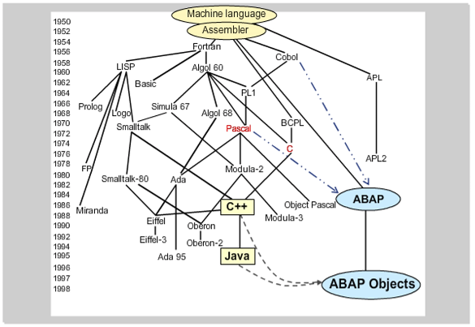
I. Introduction History of selected programming languages
All extensions are upward compatible.
The difference in ABAP Objects compared to other object-oriented languages is in the development environment. You can use the entire range of functions of the ABAP Workbench with ABAP Objects.
ABAP Objects = object-oriented extension of ABAP
Source: BC401 ABAP Objects (2011)

Slide 5
I. Introduction Procedural vs. object-oriented approach
Procedural ABAP program
Object-oriented approach
Report
Types: …
Data: wa_car type …
No direct access
Call function ‘CAR_SHOW_SPEED’
Function group “car”
CAR_ACCELERATE
CAR_STOP
gear
color
speed
speed
color
gear
CAR_GEAR_CHANGE_UP
CAR_SHOW_SPEED
CAR_ACCELERATE
CAR_SHOW_SPEED
CAR_GEAR_CHANGE_UP
Encapsulation of data and functions
The implementation of a class is invisible outside the class. Interaction takes place only by a defined interface.
Separation of data and functions

Slide 6
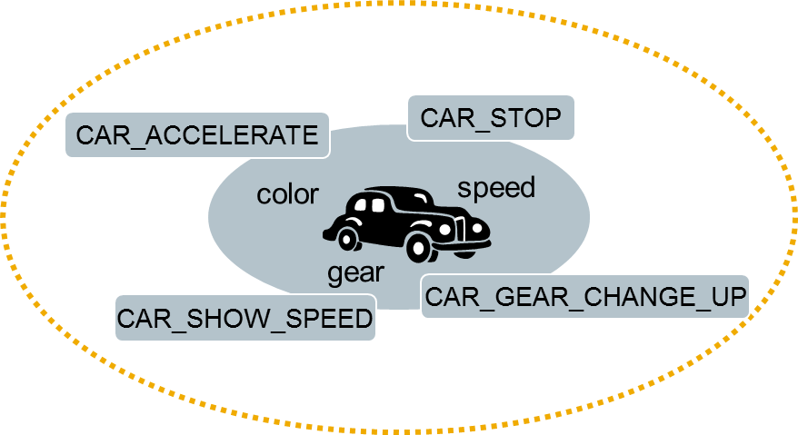
II. Principles of object-orientation Classes and Objects
Classes
General/abstract description of objects (“construction plan for cars”)
Attributes of classes specify status data (e.g. speed)
Methods describe the behavior (e.g. car_accelerate)
Objects
Objects are instances of a class (i.e. one object corresponds to one car, it is built after the construction plan of its class)
Objects represent a part of the real world (i.e. one car)
Objects are units made up of data and functions
lcl_car
Attributes
…
Methods
…

Slide 7
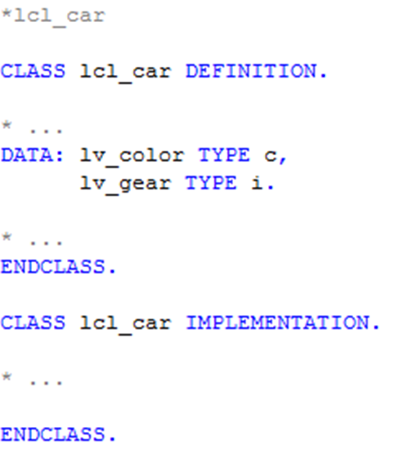
II. Principles of object-orientation Elementary syntax elements – defining a class
Classes can be created with the ABAP Editor (SE38) or the Class Builder (SE24)
The declaration of a class is split into a definition and an implementation part
Declaration of all components of your class: attributes, methods, constants, types,…
Implementation of all methods of your class

Slide 8
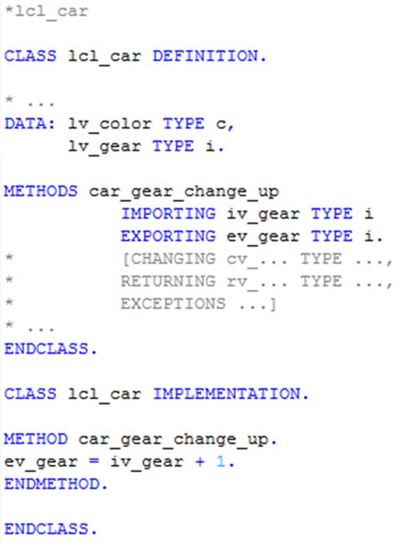
II. Principles of object-orientation Elementary syntax elements – methods
Methods have a signature, where parameters and exceptions can be passed.

Slide 9
II. Principles of object-orientation Public and private components
lcl_car
Public components
Attributes
…
Methods
get_color
…
Private components
Attributes
color
…
Methods
…
Public components can always be called/accessed
Private components can only be called/accessed from the class own methods
Design principle
Normally, data types and attributes are declared as private components. They are accessed via public methods. E.g. the private attribute color may be accessed via the public method get_color.

Slide 10
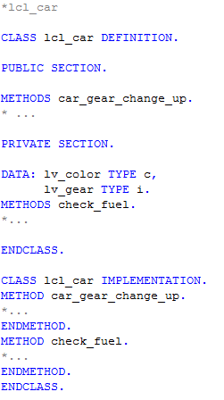
II. Principles of object-orientation Elementary syntax elements – public and private components
By default all the members of a class are PRIVATE.

Slide 11
II. Principles of object-orientation Static and instance components
Attributes
Instance attributes exist for every instance of a class, e.g. every car of class lcl_car has its own color
Static attributes exist only once per class, e.g. attribute no_of_cars
Attributes may also be declared as constants, e.g. no_of_wheels = 4
Methods
Instance methods (e.g. get_color) may access static and instance components
Static methods (e.g. get_no_of_cars ) may only access static components

Slide 12
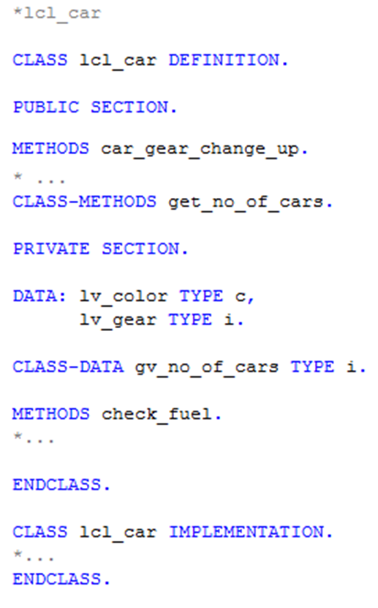
II. Principles of object-orientation Elementary syntax elements – static and instance components
Instance methods are defined by the expression METHOD(S).
Instance attributes are defined by the expression DATA.
Static methods are defined by the expression CLASS-METHOD(S).
Static attributes are defined by the expression CLASS-DATA.

Slide 13
Now you are able to do the implementation of a simple ABAP Class.
To consolidate your knowledge, you can do tasks 1 and 2 of the ABAP Objects exercises.

Slide 14

II. Principles of object-orientation Instances of classes
One object of a class = one instance of a class
The instantiation of an object is triggered by the expression CREATE OBJECT …

Slide 15
II. Principles of object-orientation Instances of classes - multiple instantiation
Multiple instances of a class may exist at the same time
Important characteristic of object-orientated programming
color = red
color = green
speed = 200 km/h
speed = 20 km/h
gear = 6
gear = 2
go_red_car
go_green_car
color = blue
speed = 120 km/h
gear = 5
go_blue_car

Slide 16
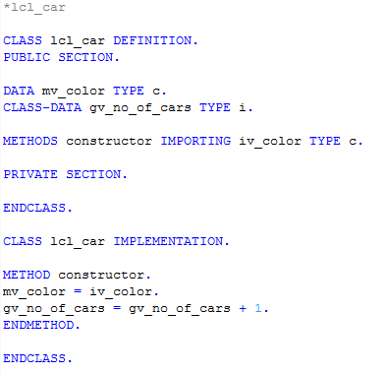
II. Principles of object-orientation Instances of classes - constructor
The expression CREATE OBJECT automatically calls the method constructor (reserved name)
The constructor method is an instance method
The implementation of the constructor method is optional (if the implementation is missing, simply a new instance is created)
There is no destructor in ABAP

Slide 17



II. Principles of object-orientation Accessing methods and attributes
Methods
Static methods:
Instance methods:
Attributes
Static attributes:
Instance attributes:

Slide 18
Now you are able to do create instances of classes and access methods.
To consolidate your knowledge, you can do tasks 3 and 4 of the ABAP Objects exercises.

Slide 19
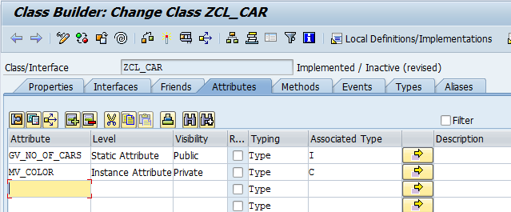
III. Global classes The Class Builder
Local classes can only be accessed within the program they have been defined and implemented.
A global class is stored centrally in the class library of the repository and can be accessed from all ABAP programs.
You can define global classes in the Class Builder (Transaction SE24).
Properties of attributes can be defined without coding.

Slide 20
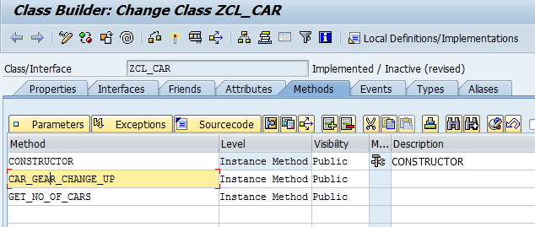
III. Global classes The Class Builder
Click here to define parameters and exceptions for your method.
Every class may have only one constructor method
Click here to implement your method.
Properties of your method can be defined without coding

Slide 21


IV. Further principles of object-oriented programming Polymorphism and inheritance
Beneath the encapsulation of data and functions, further principles of object-oriented programming exist.
Polymorphism Identically-named methods used for different classes respond according to an appropriate class-specific behavior.
Inheritance A new class can inherit attributes and methods from an existing class that can be extended by additional, own attributes and methods.
Overloading (same method with different parameters)
Overriding (implementation of subclass replaces superclass’ one)

Slide 22
IV. Further principles of object-oriented programming Inheritance - example
lcl_car Attributes: color, speed, gear
Methods: car_change_gear_up, get_color
lcl_taxi
Attributes: color, speed, gear, no_of_passengers, average_transportation_price
Methods: car_change_gear_up, get_color, get_no_of_passengers
lcl_racing_car
Attributes: color, speed, gear, sponsor
Methods: car_change_gear_up, get_color, get_sponsor

Slide 23
V. Applications of object-oriented programming Examples
Exception classes / exception handling
Odata service implementation
ALV-programming
Business Add-Ins
…

Slide 24
Now you can define global ABAP Classes with the Class Builder.
To consolidate your knowledge, you can do the Challenge of the ABAP Objects exercises.

Slide 25
Check your knowledge

Slide 26
Check your knowledge
An object in object-oriented programming represents a “construction plan”.
□ True □ False
Explain the meaning of the term “class” in the ABAP Objects context!
What is the difference between a static and an instance component of a class?
A local class can be accessed from every report in your SAP system.
□ True □ False
What happens, if the implementation of the constructor is missing?

Slide 27
Solution

Slide 28
Solution
An object in object-oriented programming represents a “construction plan”.
□ True ☒ False
Explain the meaning of the term “class” in the ABAP Objects context!
See section Principles of object-orientation
What is the difference between a static and an instance component of a class?
See section Principles of object-orientation
A local class can be accessed from every report in your SAP system.
□ True ☒ False
What happens, if the implementation of the constructor is missing?
See section Principles of object-orientation

Slide 29
References
BC401 ABAP Objects, Teilnehmerhandbuch. Version der Schulung: 92, 2011

